Slide 1

Shortest Path Algorithms: Dijkstra and Bellman-Ford
Data Structure | Graph
Course: Data Structure | Chapter: Graph | Bachelor of Engineering
DISCOVER · LEARN · EMPOWER
Notes:
Welcome everyone to today's lecture on Graph algorithms. We will focus specifically on finding the shortest paths in weighted graphs. This is a fundamental concept for network routing and navigation systems. Let us begin our journey into Dijkstra and Bellman-Ford algorithms.

Slide 2
Course Outcomes
SLIDE 2 / 14
Course Outcome
CO | BT LEVEL | DESCRIPTION
CO1 | BT1 | Understand and apply basic data structures, algorithms, complexity analysis, ADTs, arrays and linked lists.
CO2 | BT2 | Apply and implement stacks and queues in problem-solving.
CO3 | BT3 | Analyse and apply searching, sorting, and hashing techniques.
CO4 | BT4 | Construct and apply tree structures and traversal techniques.
CO5 | BT5 | Represent and solve graph problems using DFS, BFS, and graph algorithms.
Chandigarh University
2 / 14
Notes:
Today's lecture directly addresses our Course Outcomes. CO1 requires us to understand algorithms and complexity, which we will see in the time complexity of these methods. CO2 focuses on implementation, and while we use queues here, the logic of problem-solving remains central. These outcomes ensure you can apply these structures to real-world problems.

Slide 3
Learning Objectives
SLIDE 3 / 14
Learning Outcomes
1
Define the shortest path problem within weighted directed graphs.
2
Explain the greedy approach used by Dijkstra's algorithm.
3
Describe the relaxation technique used in Bellman-Ford.
4
Compare the time complexity and use cases of both methods.
5
Identify common pitfalls when handling negative edge weights.
Chandigarh University
3 / 14
Notes:
By the end of this session, you will be able to define the shortest path problem clearly. You will understand why Dijkstra uses a greedy strategy while Bellman-Ford uses dynamic relaxation. We will also compare their efficiency to know when to use which. Finally, we will identify critical pitfalls regarding negative weights.

Slide 4
Lecture
SLIDE 4 / 14
The Shortest Path Problem Definition
1
The goal is to find the path with minimum total weight between two vertices.
2
A path is a sequence of edges connecting a source vertex to a destination.
3
The total weight is the sum of individual edge weights along the path.
4
Graphs can be directed or undirected with positive or negative edge weights.
5
This problem is critical for GPS navigation and network routing protocols.
6
We assume the graph is connected for the path to exist between nodes.
Chandigarh University
4 / 14
Notes:
Imagine you are driving from Chandigarh to Delhi and want the fastest route. The shortest path problem asks for the path with the minimum sum of edge weights. If edges represent distance or time, we sum them to find the optimal route. This concept applies to any network where connections have costs.

Slide 5
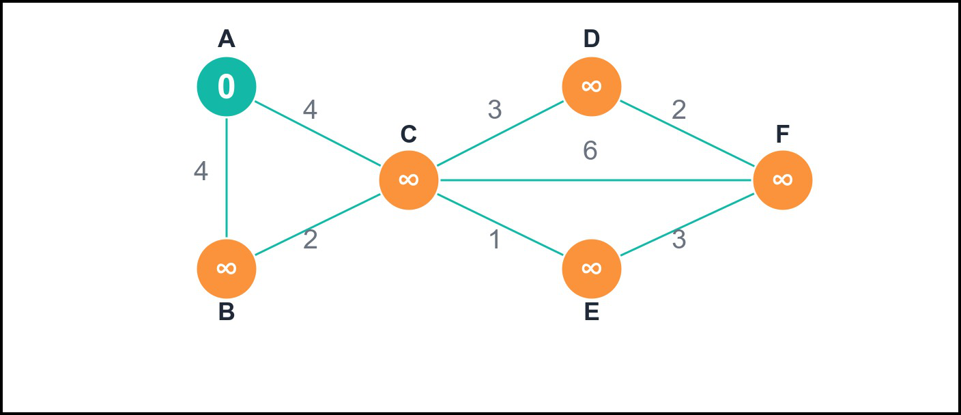
Dijkstra's Algorithm
SLIDE 5 / 14
Core Concept
1
Dijkstra's algorithm uses a greedy strategy to find shortest paths from a source.
2
It maintains a set of visited vertices with known shortest distances.
3
At each step, it selects the unvisited vertex with the smallest tentative distance.
4
The algorithm relaxes edges connected to the selected vertex to update neighbors.
5
It guarantees the shortest path only if all edge weights are non-negative.
6
It uses a priority queue to efficiently select the next vertex to visit.
Source: static-assets.codecademy.com
Chandigarh University
5 / 14
Notes:
Dijkstra's algorithm works by always picking the closest unvisited node. Think of it like a ripple spreading out from a stone dropped in water. It expands the ripple to the nearest neighbor first, ensuring the shortest path is found. However, this greedy approach fails if any edge has a negative weight.

Slide 6
Dijkstra's Algorithm
SLIDE 6 / 14
Working Principle
1
Initialize the source distance to zero and all other distances to infinity.
2
Insert all vertices into a priority queue ordered by their current distance.
3
Extract the vertex with the minimum distance from the priority queue.
4
For each neighbor, calculate the new distance through the current vertex.
5
If the new distance is smaller, update the neighbor's distance and parent.
6
Repeat until the priority queue is empty or the destination is reached.
Chandigarh University
6 / 14
Notes:
We start by setting the source distance to zero and everything else to infinity. The algorithm repeatedly picks the node with the smallest known distance. It then checks all neighbors to see if a shorter path exists through the current node. This process continues until all reachable nodes are processed.

Slide 7
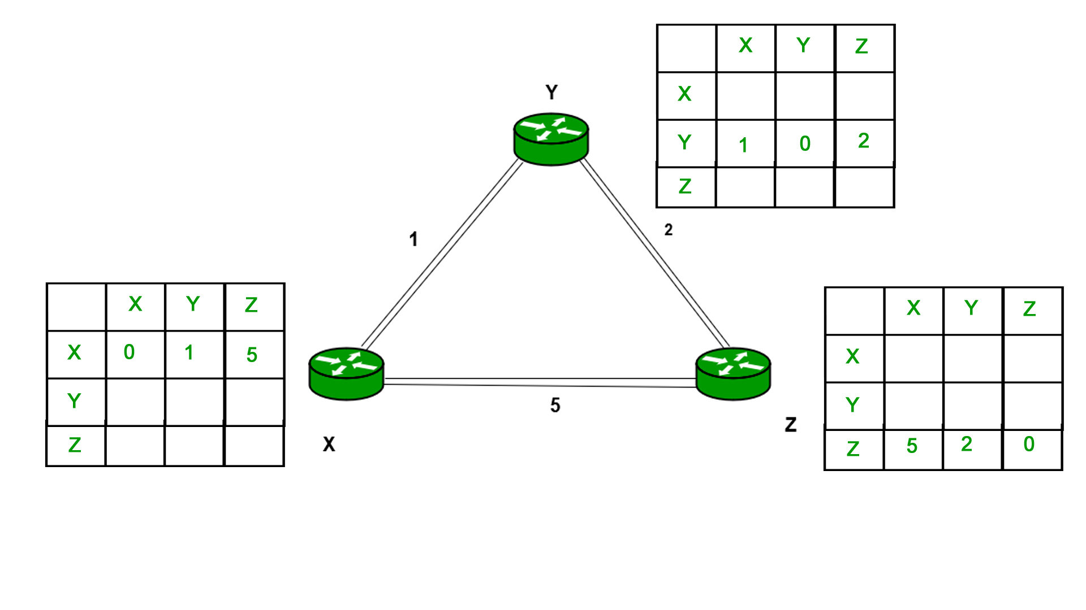
Dijkstra
SLIDE 7 / 14
Worked Numerical Example
GOVERNING EQUATION
Select B (min dist 3), no shorter path to D found (3+2=5)
FINAL SHORTEST PATHS
A->C(2), A->B(3), A->D(5).
• Consider a graph with nodes A, B, C, D and weighted edges.
• Start at node A with distance 0; all others are infinity.
• Select A, update B (dist 4) and C (dist 2) via relaxation.
• Select C (min dist 2), update D (dist 2+3=5) and B (dist 2+1=3).
Source: media.geeksforgeeks.org
Chandigarh University
7 / 14
Notes:
Let's trace this with a simple example. Starting at A, we see C is closest at distance 2. From C, we can reach B with a total distance of 3, which is better than the direct path of 4. Finally, D is reached with a total distance of 5. This step-by-step update ensures we find the true minimum.

Slide 8
Lecture
SLIDE 8 / 14
Bellman-Ford Algorithm: Core Concept
1
Bellman-Ford solves the single-source shortest path problem for any graph.
2
It can handle graphs with negative edge weights where Dijkstra fails.
3
The algorithm relaxes all edges repeatedly for V-1 iterations.
4
It uses a dynamic programming approach to build shortest paths incrementally.
5
It can also detect negative weight cycles reachable from the source.
6
It is slower than Dijkstra but more robust for general weighted graphs.
Chandigarh University
8 / 14
Notes:
Bellman-Ford is the robust alternative to Dijkstra. It works even when edges have negative weights, which is common in financial or game theory graphs. The algorithm relaxes every edge in the graph repeatedly. This ensures that even if a negative edge appears later, the path is corrected.

Slide 9
Lecture
SLIDE 9 / 14
Bellman-Ford: Working Principle
1
Initialize source distance to zero and all others to infinity.
2
Iterate V-1 × where V is the number of vertices in the graph.
3
In each iteration, relax every edge (u, v) with weight w.
4
Relaxation updates distance[v] if distance[u] + w is less than distance[v].
5
After V-1 iterations, check for negative cycles by attempting one more relaxation.
6
If any distance decreases in the V-th iteration, a negative cycle exists.
Chandigarh University
9 / 14
Notes:
The core logic involves relaxing all edges V-1 ×. In each pass, we check if going through a specific edge improves the path to a node. If after V-1 passes, we can still improve a distance, it means there is a negative cycle. This makes it unique in its ability to detect such anomalies.

Slide 10
Lecture
SLIDE 10 / 14
Bellman-Ford: Worked Numerical Example
GOVERNING EQUATION
Final distances: A=0, B=1, C=2
1
Graph with nodes A, B, C and edges: A->B(4), A->C(2), C->B(-1).
2
Iteration 1: Relax A->B (dist 4), A->C (dist 2), C->B (dist 1).
3
Iteration 2: No further updates as all shortest paths are found.
4
The negative edge C->B reduced the path to B from 4 to 1.
5
This demonstrates handling negative weights that Dijkstra cannot process.
Chandigarh University
10 / 14
Notes:
In this example, the edge from C to B has a weight of -1. Initially, we might think the path to B is 4. However, going through C gives us 2 + (-1) = 1. Bellman-Ford catches this because it checks all edges repeatedly. Dijkstra would have missed this update because it finalizes nodes too early.

Slide 11
Complexity Analysis
SLIDE 11 / 14
Time and Space
1
Dijkstra's time complexity is O(E + V log V) using a binary heap.
2
Bellman-Ford time complexity is O(V × E) due to V-1 iterations.
3
Dijkstra uses O(V) space for the distance array and priority queue.
4
Bellman-Ford uses O(V) space for the distance array and parent pointers.
5
Dijkstra is faster for sparse graphs with non-negative weights.
6
Bellman-Ford is slower but necessary for graphs with negative edges.
Chandigarh University
11 / 14
Notes:
Let's compare their efficiency. Dijkstra is generally faster, especially with a priority queue. However, Bellman-Ford is slower because it checks every edge multiple ×. You choose Dijkstra for speed when weights are positive, and Bellman-Ford when you need to handle negative weights or detect cycles.

Slide 12
Lecture
SLIDE 12 / 14
Common Pitfalls and Limitations
1
Using Dijkstra on graphs with negative weights yields incorrect results.
2
Failing to initialize distances to infinity causes logic errors in implementation.
3
Not handling disconnected components can lead to infinite loops or errors.
4
Confusing the number of iterations in Bellman-Ford with the number of edges.
5
Ignoring negative cycles can cause infinite loops in path reconstruction.
6
Using an array instead of a priority queue slows down Dijkstra significantly.
Chandigarh University
12 / 14
Notes:
A common mistake is applying Dijkstra to a graph with negative weights. This will give you the wrong answer because the greedy assumption breaks. Another pitfall is not initializing distances correctly. Always start with infinity for unvisited nodes. Also, be careful with negative cycles in Bellman-Ford.

Slide 13
Lecture
SLIDE 13 / 14
Key Takeaways
1
Dijkstra is a greedy algorithm for non-negative weighted graphs.
2
Bellman-Ford handles negative weights and detects negative cycles.
3
Both algorithms use the relaxation technique to update shortest paths.
4
Dijkstra is faster O(E + V log V) while Bellman-Ford is O(VE).
5
Always verify edge weights before selecting the appropriate algorithm.
Chandigarh University
13 / 14
Notes:
To summarize, Dijkstra is your go-to for positive weights due to its speed. Bellman-Ford is essential when negative weights are present. Both rely on relaxation to find the optimal path. Remember to check your graph's properties before choosing which algorithm to implement.

Slide 14
Lecture
SLIDE 14 / 14
References
DATA STRUCTURES
A Pseudocode Approach with C — Gilberg, Forouzan
• Data Structures — Lipschutz
• Data Structure Using C — AK Sharma
• C and Data structure — P. S. Deshpandey
Chandigarh University
14 / 14
Notes:
These textbooks provide comprehensive coverage of graph algorithms and their implementations. I recommend reading the chapters on graphs in Gilberg and Forouzan for detailed pseudocode. Lipschutz offers excellent theoretical foundations, while Sharma and Deshpandey provide practical C implementations. Please refer to these for further study.

